Slide 1


AmazonCars Portfolio

Slide 2
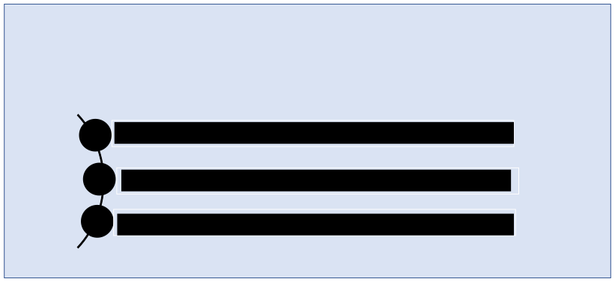
Professional Background
Zoe Ndedde is a junior Product Manager with past experience as a Virtual Assistant/Digital Marketer and Project Manager, remotely working with tech and non-tech firms to grow and enhance their brand. These prior experiences have made her view points customer-centric, detail oriented and strategic in terms of how she formulates her work.
VIRTUAL ASSISTANT
PROJECT MANAGEMENT
DIGITAL MARKETER

Slide 3

Abstract
The amazon cars case study is an analysis of the possible approach that amazon could use if and when they decide to launch the amazon cars section of the company. The portfolio analyses and provides concise data gotten through weeks of research, interviews and observations. Several methods such as identifying the problem statement, assumption mapping, plotting a risk importance graph, conducting a market validation, conducting user interviews and selecting a MVP strategy etc. were used to arrive at a well informed conclusion for the case study.

Slide 4

Portfolio Outline
Table of Contents
• • • • • • • • • • • •
Professional Background Abstract Table of Contents Problem Statement
Assumption Mapping –Risk Importance
Graph Market Validation User Interviews MVP Strategy User Stories and Features Prioritization and Estimation Effort / Value Map Conclusion

Slide 5
Problem Statement
For [Individuals who enjoy shopping online and would want to purchase cars with convenient payment plans/options] Do individuals want to shop for cars online? Do they want payment plans and options? Who have [a need to access and purchase car information/cars conveniently]
[Amazon Cars] Is a [website] That [enables online access and purchase of cars] Unlike [the traditional car purchase process] My Product [is cheaper, convenient, reliable and offers payment options and plans] We’ll know this is true when [people are purchasing via Amazon Cars more than at physical dealerships]

Slide 6

Assumption Mapping
1)Customers want easy and convenient and car purchase process. 2)Customers want to be able to access insurance. 3)Customers want to be able to access mileage information 4)Customers want to be able to access accident history 5)Customers want car deals at the best prices. 6)Customers want to purchase cars online. 7)Customers are fed up with traditional car dealerships.
8)Customers want convenient payment plans and options

Slide 7
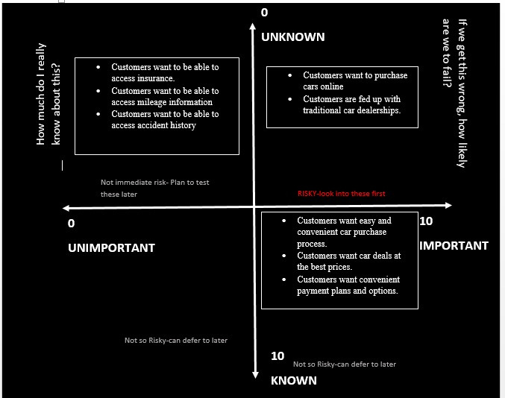

Risk Importance Graph
The purpose of the risk importance graph is to point out the level of importance of each of the assumptions made Some of these assumptions are unknown but important because they likely are the core/foundation upon which the product would be developed.
Similarly, some of these assumptions are unknown and unimportant because the product could still be developed with or without them and they would simply be add-ons
Finally, some of these assumptions are also known and important because they are factors without which the entire product would not exist at all.

Slide 8

Market Validation-Target Market
-What need does the product/service fulfil?
The product offers individuals who want to purchase cars an easy and convenient purchase process online. This convenience is one that traditional car dealerships have been unable to achieve. -Are there any problems or pain points it solves? Our product solves an array of pain points ;long documentation, physical inspection and strenuous negotiation and payment process. On the contrary our product does not require bulky documentation, all car specifications and info are online and we have payment plans available to suit every client's needs. -Who would benefit most from the product or service? Prospective car owners, with stable income sources (or pension), aged 25-60 My target market are individuals/automobile customers who enjoy shopping online and would want to purchase cars with convenient finance and payment options Specific Target Market Demographic information: Income earners/Pensioned, middle class, 25-60 Geographic information: Urban area residents (wherever Amazon operates) Psychographic information: Individuals who enjoy online shopping Behavioral information: Individuals who have need for private transportation to minimize cost from public transportation

Slide 9


Market Validation
Market Growth The growth prospect is high with statistical forecast showing that the global online car buying market size was US$ 261.9 billion in 2021. It is forecast to grow to US$ 721.6 billion by 2030 at an compound annual growth rate of 13.2% from 2022 to 2030.
Market Competitors AutoNation, Inc. Car gurus, Inc. Cars Direct Asbury Automotive Group, Inc Cox Automotive Inc Lithia Motors, Inc. HendrickAutomotive Group
Market validation is used to determine whether or not there is a need for a product in the market and is also used to recognize who the target market for a product might be. Market growth is information about the rise in demand for a product in the market and it is also a tool for forecasting just how much growth the market for
a product would see. The market competitors are already existing products in the market.

Slide 10

User Interviews
Customer survey process:
Questionnaires were created based off questions that were relevant to the users and the product. The questions were crafted in a way that user’s answers would provide first hand information as to what their needs would be and also provide a vivid idea of what they would consider a satisfactory online shopping experience on the automobile website.
Questionnaires had spaces where users could input feedback and distributed via Google forms to
target groups over span of 3 days. Target customers were individuals who were between the age of
25-60, employed/Self employed-Income earners/Pensioned.

Slide 11
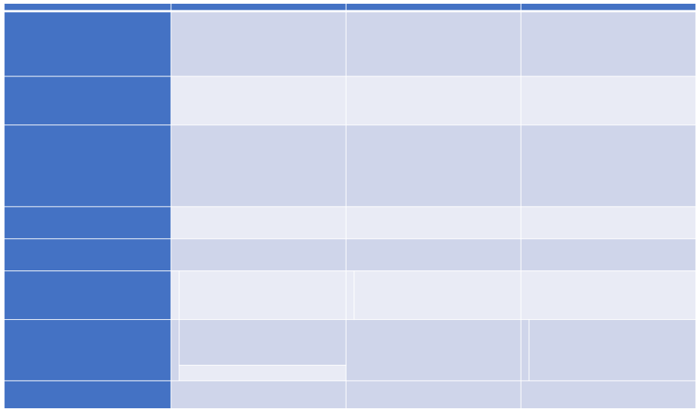
User Questions
Interview 1
User Interviews
Interview 2`
Interview 3
What is your reason for wanting Graduate wants to cut daily
Tech recruiter wants to get to
Entrepreneur wants to make delivery for cosmetic products.
to purchase a car?
spending on public transportation. work on time and bypass public
Needs to move around quick and without delay.
Travelled to neighboring town to
find a cheaper vehicle.
transportation.
How did you go about it?
Consulted a friend who suggested Consulted a friend for car
an online platform that offered a
variety of automobile options. Car was in great shape and durable, Had headrest television, camera for reverse and navigation system.
dealerships.
What made you select the car
Vehicle had low fuel consumption
Car had low cost of maintenance,
you purchased?
rating, panoramic roof and good traction. Mileage was not very high and car had a very spacious storage compartment.
electric steering, consumed low fuel and great sound system.
Conducted physical inspection
with friend.
Used a payment plan offered by
an online platform
Therewasnoneedtobecause
vehiclewasbrandnew.
Paid with cheque.
DidyoucarryoutaphysicalGot a mechanic to come in and
inspection?
How and in what form was
payment made?
Were there any moments of
frustration during the process?
carry out physical inspection.
Paid cash in full.
Yes, the search process was long
and tedious before arriving at a
durable car that fit the budget.
Spent hours searching for the
right. Time and energy were
consumed.
Dealer tried to rip me off,
different vehicles had different
internal issues.
Test driving cars definitely made
up for the slightly frustrating
experience of searching.
What would you say was the
best part about purchasing the
car?
Were there any issues
The car of choice was worth it, top Tcar is fuel efficient,
notch performance and great
vitals.
hParts are also cost effective and
e easy to find.
Yes, the AC compressor got faulty
Car tire sensor had to be replaced. No issues.

Slide 12
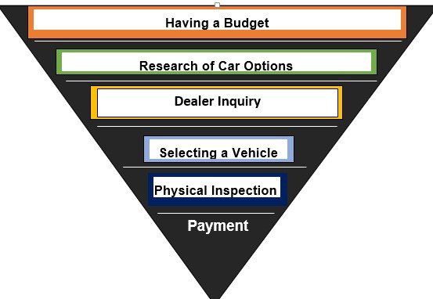
Car-Buying Process User Journey

Slide 13

Car-Buying Process User Journey
1)Budgeting-This is an important stage when purchasing a car. It involves deciding on how much one can afford. 2)Research of Car Options-Whether one is going for a new or used car it is best to carry out a research of
options that fall into ones budget range.
3)Dealer Inquiry-This is one of the most vital steps because it involves making enquiry from dealers about the
car the customer wants and narrowing down the physical location of the car.
Locating and Selecting the Car of Choice
4)
5)Physical Inspection; This part of the car purchase process because involves physically to checking the state and
vitals of the car a person intends to purchase. It also ensures the likelihood of you getting the car you actually
want
6)Getting a professional mechanic to carry out necessary checks-This is especially important if one is buying a
used car because you want to be sure you are not purchasing a vehicle that is not fit to be on the roads and
may be unsafe to drive.
7)Car price negotiation and payment-This is the final step in the car purchase process. Making adequate findings
about a particular car helps a customer to avoid getting ripped off during the payment and negotiation
process.. Taking delivery of vehicle or driving off with vehicle.

Slide 14
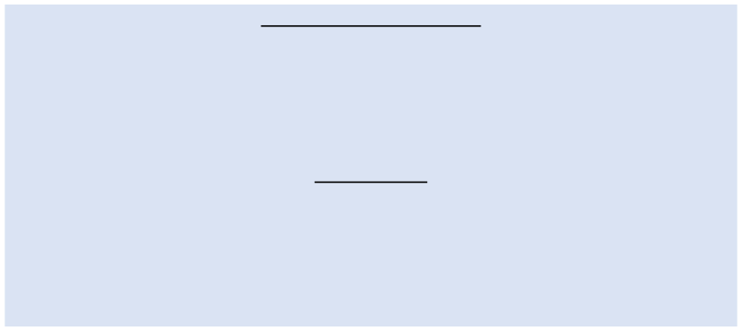
MVP
Amazon Cars Key Assumptions
1)Customers want easy and convenient car purchase process. 2)Customers want to be able to access insurance. 3)Customers want car deals at the best prices. 4)Customers want to purchase cars online. 5)Customers are fed up with traditional car dealerships. 6)Customers want convenient payment plans and options Success Criteria 1)The number of customers that are subscribed to our payment plans 2)The number of registered users 3)The number of customers subscribed to our insurance plans 4)The percentage of click-through rate 5)Percentage of cars sold bi-annually 6)Customer ratings & reviews
The purpose of these is to continuously test assumptions and find out which of these assumptions are key to the development of the product.

Slide 15

Prototype Strategy
My prototype of choice is a website. This is because in such a digital age, people are on their devices more and are likely find it more convenient than traditional car dealerships. Therefore, the use of a website would make it easier to monitor our growth through metrics such as click through rate, online traffic, email subscriptions etc. The website offers features such as payment plan feature where customers can pick finance plans that fit their budget or current income. A car insurance feature would be included. Search functionality/filter would be included to make the search process easy to navigate. There would be a 360°virtual showroom to create a realistic and interactive user shopping experience.
There would also be a compare cars feature where users can compare up to cars of different brands at
once. There would be a pop up chat feature where users can interact with an Amazon Cars representative to serve as a guide during their purchase process. This representative feature would also handle enquiries customers may have at any given time.

Slide 16

Finding Users
Seeing as the target market has already been specified, we intend to find users by drafting surveys which contain questions that would pinpoint the users that are eligible for the product. A landing page is our best approach at giving our target market a comprehensive introduction to our product. From our landing page, users can sign up to be a part of the prototype testing. We would also run targeted ads on Instagram, Twitter and LinkedIn to source for users to test the prototype.

Slide 17

User Stories
Customer Research 1
Mr. and Mrs. Ademide are newlyweds who would like to purchase a durable vehicle that would help with their day to day movements amidst being short on cash for the time being. Due to this, they want to purchase a vehicle that they can access a payment plan on. They want to be able to pay in installments but be able to use the vehicle while doing so.
User Story 1
As newlyweds, we want to have access to payment plans on a car so as to be able to select a vehicle which we can afford. Feature 1 The website will have a feature in the payment section that allows users to access different payment plans. It will also provide the customers with the option of making the vehicle payments over a mutually agreed period of time. This allows the couple to pay at their convenience and within their financial capacity.
A user story is a tool used in agile software development to capture the description of a software feature from an end-user perspective. The user story describes the type of user, what they want and why, A user
story helps to create a simplified description of a requirement.

Slide 18

User Stories
Customer Research 2 Mrs. Lisa is a single parent that would like to get a car that has enough space and safety features to transport her family without having to worry a lot about the safety of her children. She hopes to find a car that best suits her
needs during the online search process.
User Story 2 As a single parent, I want to be able to purchase a spacious and safety enhanced vehicle conveniently so I can comfortably transport my kids to school and back home. I hope to be able to figure out the best possible car
during my search on the website.
Feature 2 The website will have search filter feature that can aid customers narrow down their searches based on their needs. There is a search filter with car ratings based on safety features from Child Lock, rear seats seatbelts, side Airbags and more. It will also include the most recent industry level safety features. The purchase process will be
straightforward and hassle-free.
A user story is a tool used in agile software development to capture the description of a software feature from an end-user perspective. The user story describes the type of user, what they want and why, A user
story helps to create a simplified description of a requirement.

Slide 19

User Stories
Customer Research 3
Mr.Kevin has been a delivery man for 4 years with a faulty delivery van. He has had to carry out continuous major repairs which have taken a toll on his finances and delivery times. He is looking to purchase a vehicle with low fuel consumption that can withstand long hours of use. User Story 3 As a delivery man, I want to be able to find a big vehicle that is fuel efficient with parts that can be easily found in times of repair. I believe this would help me meet up with my job targets and set new milestones. Feature 3 There will be a feature that allows users to be able to have a quick response conversation with an Amazon cars representative. This chat box will serve as an accessible guide to a buyer during their purchase process.
A user story is a tool used in agile software development to capture the description of a software feature from an end-user perspective. The user story describes the type of user, what they want and why, A user
story helps to create a simplified description of a requirement.

Slide 20

User Stories
Customer Research 4
Caleb is a young man in his early 30’s who enjoys spending the weekends with his friends, he is looking to purchase the perfect vehicle that allows him to comfortably go on evening drives luxuriously and comfortably. He wants to go through a range of vehicles that match his needs. User Story 4 As a sociable young man, I want to browse through an array of cars while being able to compare and contrast them. This way I can make the best possible choice that suits my needs while spending time with my friends. Feature 4 The website will have a compare feature that allows customers to access and browse through a range of vehicles, compare vehicles with sufficient information to make a well informed decision on the vehicle they want to purchase.
A user story is a tool used in agile software development to capture the description of a software feature from an end-user perspective. The user story describes the type of user, what they want and why, A user
story helps to create a simplified description of a requirement.

Slide 21
User Stories
Customer Research 5
Madeline is a new Masters Graduate who wants to purchase her first car. She wants a trusted platforms that allows her to choose between vehicles in her budget and make comparisons before making a purchase. She also wants to be able to view the insides of the car along with all the car information and specifications make her perfect first choice.
User Story 5 As a new car owner, I want to be able to get a proper view of my car choices online so I can make a well informed decision when I decide to make a purchase. Feature 5 There will be a 360°virtual show room feature for users to get a view of vehicles between vehicles before making a purchase. There will also be an option to speak with an amazon cars representative for more information on the cars that they may likely not find on the platform.
A user story is a tool used in agile software development to capture the description of a software feature from an end-user perspective. The user story describes the type of user, what they want and why, A user
story helps to create a simplified description of a requirement.

Slide 22
User Stories
Customer Research 6
David is an Uber driver that experiences lo fuel very often during his trips. He is looking to purchase a vehicle that is fuel efficient and comfortable to transport his passengers to their respective destinations. On too many occasions he has had to disappoint his customers due to being late, interrupted trips to buy fuel or not being able to complete trips. He wants to be able to run his business smoothly.
User Story 6
As a taxi driver, I want to purchase a car that is fuel efficient. This would help me transport as much customers as possible to their various destinations without interruptive gas station visits. Feature 6 On the website, each vehicle’s information page will display Fuel Efficiency Ratings (FEV), to let the customer know how much fuel the vehicle consumes over a period of time. It will also display the quantity of gas the vehicle would need. There would also be a section that compares and contrasts each vehicles fuel consumption level.
A user story is a tool used in agile software development to capture the description of a software feature from an end-user perspective. The user story describes the type of user, what they want and why, A user
story helps to create a simplified description of a requirement.

Slide 23
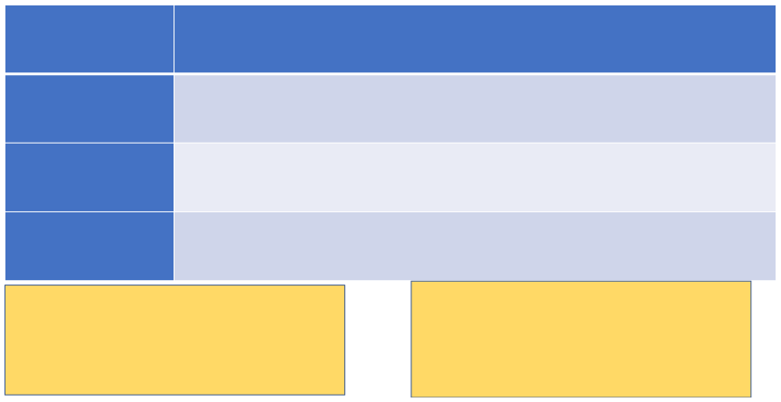
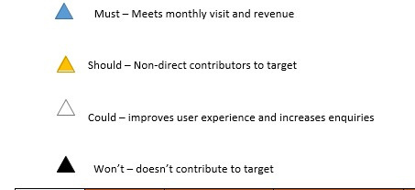
MSCW Framework on Features
Car Search/Filters, Car Comparison, Payment Plan, Car Insurance
MUST
Car Representative, Car Hire, Virtual Showroom, Customer membership
SHOULD
Similar Cars, Chat Feature, Test Drive
COULD
Customer Referrals, Purchase Reviews
WON’T
This framework gives a clear preview of the hierarchy by which the product features are classified and explains the purpose behind each part of the MSCW framework with regards to the product features.

Slide 24
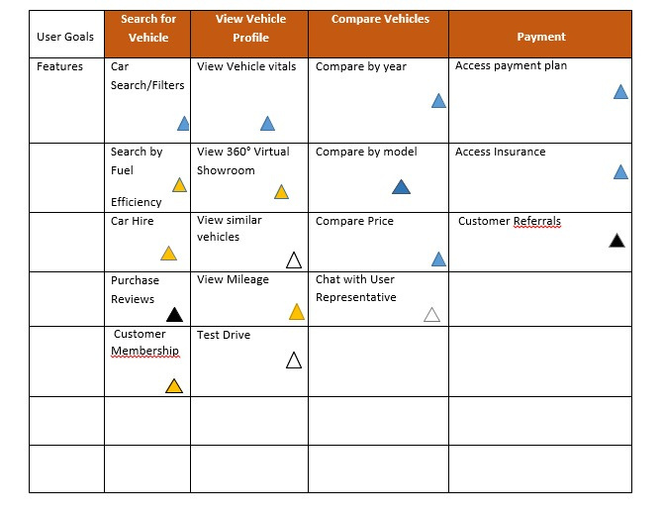

Slide 25
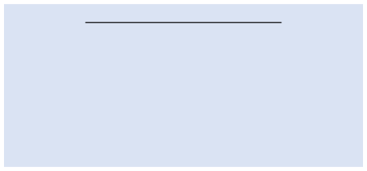
Effort Estimation using T Shirt Size
Estimating Effort with the T-Shirt
XL–Virtual Showroom, Chat Feature. L–Car Search/Filter, Car Comparison, Similar Cars, Test Drive. M–Payment Plan, Car Insurance, Customer Membership. S–Representative, Customer Referrals, Customer Reviews, Car Hire.
The T-shirt framework is a product management estimation and capacity planning tool that helps you
track how much time or effort an initiative will take. This framework is used by selecting shirt sizes and deciding what each size represents.

Slide 26

Effort Value Map
HIGH VALUE
Payment Plan Test Drive Car Insurance Representative Car Search/Filter
Virtual Showroom Chat Feature Car Comparison
Similar Cars
Purchase Reviews
Car Hire
LOW VALUE
Customer Membership Customer Referrals
LOW EFFORT
HIGH EFFORT
•
A Value-Effort Map is a tool that enables the team figure out what to work on next. It visually summarizes pieces of work in terms of the value the work will deliver and the effort that is required to get the work done.

Slide 27

Rationale Summary
User Feature –360°Virtual Show room
This feature was created to allow users have a realistic, interactive and authentic user shopping experience by being able to view.
User Feature-Customer Membership
This feature allows users to sign up to be permanent members on the website, giving them access to certain exclusive rights.
User Feature-Customer Referrals
This is a feature that reduces sales expenses and is very likely to build our level of satisfied customers.
User Feature-Car Insurance
This is a feature customers can take advantage of toprotect their cars against financial loss in the event of an accident or theft.
User Feature –View similar cars
This feature was created to allow users see vehicles that share similarities with the current chosen vehicle.
User Feature –Search by Mileage
This feature was created to allow users to view the mileage information of the currently selected vehicle, both in miles and kilometers.
User Feature –View Fuel Efficiency Rating
This feature provides the users with fuel efficiency information, these include the average mile per gallon in city or on highway, the fuel efficiency rate and the fuel tank capacity.

Slide 28

Rationale Summary
User Feature-Car Search/Filter
This feature gives the user an array of metrics by which they can search up a vehicle during their purchase.
User Feature-Test Drive
This feature lets users test drive the vehicle(s) of choice to aid them make a satisfactory decision.
User Feature-Purchase Reviews
This feature lets new users view the opinions of prior customers and their shopping experience.
User Feature-View Payment Plan
This allows customers to view the different finance plans they can have access to make for a seamless purchase process and suit their finances.
User Feature –Compare by model
This feature provides the users with the option of comparing two or more vehicles by their model, these could be similar or dissimilar vehicles.
User Feature –Compare by price
This feature provides the users with the option of comparing two or more vehicles by their price/value.
User Feature –Speak to User Representative
This feature provides the users with the option of speaking to an amazon cars user representative, so as to be able to gain more information on a vehicle or more. The rep could also help out with other vehicle related enquiries.
User Feature –Access payment plans
This feature provides the users with access to several payment plans with the goal of allowing them select a plan that works for them and allows them purchase a vehicle via instrumental payments.

Slide 29

Conclusion
Throughout my PM journey, I have learnt a good number of product management terms, techniques and the part they play in solving product management problems. I have learnt in detail the Product Management Process; from Discovery to Delivery and Market Adoption. Within these three stages are processes like road-mapping, writing user stories, drawing a risk importance graph, flowcharting, creating product assumptions and filtering the important assumptions, conducting user surveys and interviews. I have also been able to learn how to ideate a potential product solution and conducting analysis to refine it into a working solution. Some of the other techniques I have picked up during the course of this case study
include market validation, prototyping and finding users for tests, applying the MSCW Framework, using
the effort estimation tool and creating an effort value map.

Slide 30

Amazon Cars Portfolio
Thank You

